Slide 1

University of Arizona NASA AZ Space Grant Peer Engagement Study
Daniel Diaz-Brown
Ariel Fry
Beza Gebru
Dana Lerch
Yvette-Marie Margaillan
Leila Shevins
Stephanie Wogan

Slide 2

Agenda
Introduction: Beza Gabru
Recruitment: Yvette-Marie Margaillan
Cultural Values and Norms: Danny Diaz-Brown
Mentoring and Leadership: Dana Lerch
Areas of Study: Stephanie Wogan
Student Involvement and Retention: Leila Shevins
Closing Points: Ariel Fry

Slide 3
Project Objective and Diversity
Beza Gebru, Geography and Anthropology

Slide 4
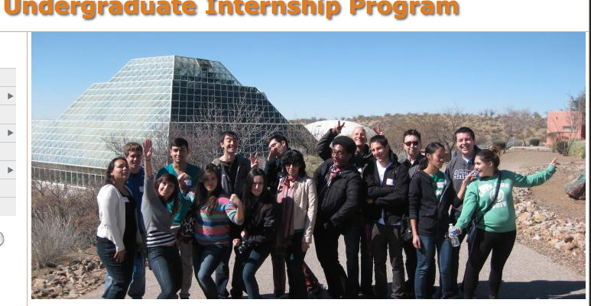
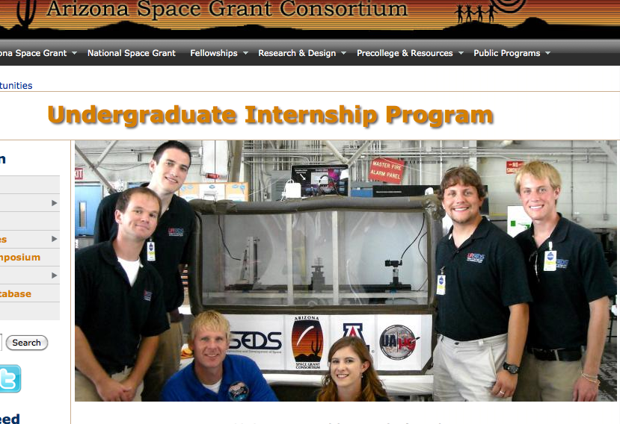
UA NASA Space Grant Consortium
Arizona Space Grant Consortium is an undergraduate internship program that trains professionals for STEM related careers through internships that incorporate education with research.
Project Objective:
Grow the number of UA/NASA Space grant undergraduate interns from populations underrepresented in STEM fields and maximize their level of engagement.
      Identify
      Recruit
      Engage

Slide 5
Observing Diversity
Diversity is the variety of experience, age, physical ability, religion, race, ethnicity, gender, and many other attributes that contributes to the richness of the environment.
Diversity in Science and Academia
The variety in discipline, intellectual outlook, cognitive style, and personality that gives a range of ideas that constitute a dynamic intellectual community.

Slide 6
Does Diversity Produce Better Science?
Cumulative research provides evidence that a diverse student body, faculty, and staff benefit creativity, innovation, and problem-solving skills.
Promoting Diversity in Research:
Research showing that diverse teams are better at solving complex problems. On homogeneous teams, unquestioned assumptions remain unquestioned, and everyone gets stuck in the same place. If we only listen to people who agree with us, we cease to grow .
Does Diversity On Research Team Improve Quality Of Science? NPR
  Study found that publications with diverse teams reach broader audiences, greater citation (Vendantam, 2014) .
Notes:
Fertig, B. (2014, April 1). Changing the Face of Astronomy [web log post]. Retrived April 1,2014 From, http://www.npr.org/2014/04/02/297714630/changing-the-face-of-astronomy-research
2 Vedantam, S. (2014, March 21). Does Diversity on Research Team Improve Quality of Science. [web log post]. Retrieved March 22,2014, From http://www.npr.org/2014/03/21/292225798/does-diversity-on-research-team-improve-quality-of-science

Slide 7
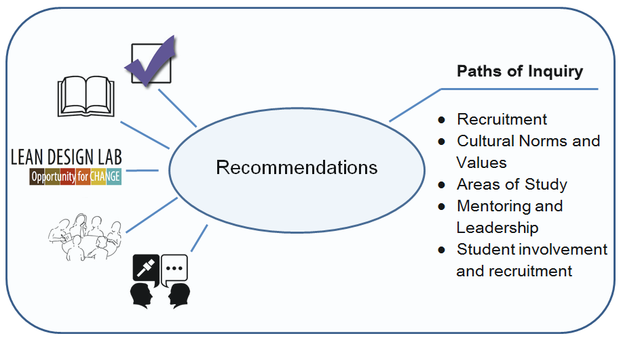
AZSG Peer Engagement Study: Research Methods

Slide 8
Recruitment
Yvette-Marie Margaillan
Management Information Systems, Finance

Slide 9
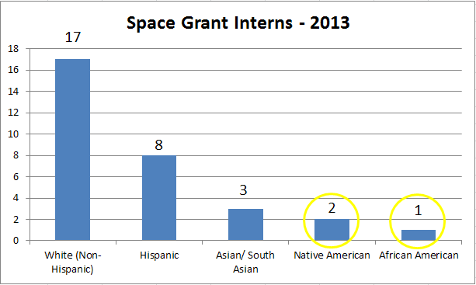
U of A Recruitment - 2013
31 Current Space Grant Interns

Slide 10
Who is Interested in STEM?
-According to our survey of 50 high-potential high school students from underprivileged areas, 84% of respondents show an interest in pursuing degrees in STEM
-All 50 participants showed an interest in pursuing at least a Bachelor’s degree
- 48 of the participants are minorities
Survey conducted at the Be A Leader Foundation, Phoenix AZ

Slide 11
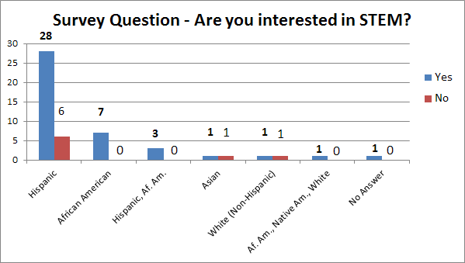
Breakdown by Ethnic Background
Survey conducted at the Be A Leader Foundation, Phoenix AZ

Slide 12
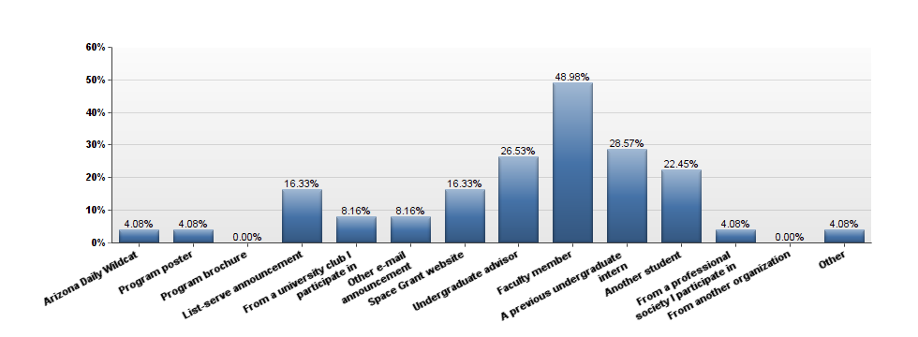
Past Recruitment Strategies
Notes:
Go take the slide from the previous version of this...the one that Lelia had in her section. that is no longer in her section because it had nothing to do with retention.
I would not leave this as is as it is false representation of what the space grant has done and is likely to offend Barron and Susan
This slide isn’t negative or false, its what we know they have used, so I am stating it. I have a slide at the end of my presentation that was leilas. That was the best spot for it. I finished formatting my slides so it is done now. any additional info I get I will present verbally in the correct order :)

Slide 13
What Attracts Applicants?
Focus Groups and Peer Interviews with Student Organizations
African Student Association Arizona Assurance
Eller Unity Board Women in Engineering Association
What Works:
A combination of emails and word of mouth (especially from past interns & professors)
What doesn’t work:
Content heavy flyers

Slide 14
What Do Applicants Seek?
Top 3 Reasons
-Experience (research in particular)
-Mentorship and hands-on guidance
-Monetary compensation

Slide 15
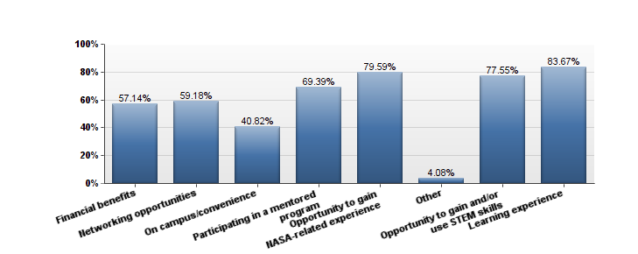
Alumni Responses
The alumni survey respondents’ primary reasons
for applying to the AZ Space Grant Consortium internship

Slide 16
Cultural Norms and Values
Daniel Diaz-Brown
Management Information Systems, Finance,
Operations Management

Slide 17
Cultural Norms and Values
Will understanding the cultural norms and values of the target groups assist in recruiting and engaging them?
Will having similar mentors help with recruiting more underrepresented minorities and women into STEM?
“The idea that women and minority faculty members exert a role-model effect on women and minority students is a widely held belief in academia” (Rask & Bailey. 2002)
“However, a 1995 paper by Canes and Rosen, also using institutional data, finds no link between the percentage of female faculty in a department and the percentage of majors that are female” (Griffith, 2010)
Notes:
Rask, K., & Bailey, E. (2002). Are faculty role models? evidence from major choice in an undergraduate institution. Manuscript submitted for publication, Retrieved from http://citeseerx.ist.psu.edu/viewdoc/download?doi=10.1.1.195.5082&rep=rep1&type=pdf
Griffith, A.L. (2010). Persistence of women and minorities in STEM field majors: Is it the school that matters?
[Electronic version]. Retrieved [insert date], from Cornell University, School of Industrial and Labor Relations site: http://digitalcommons.ilr.cornell.edu/workingpapers/122/

Slide 18
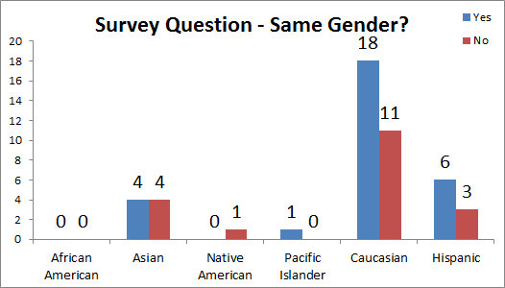
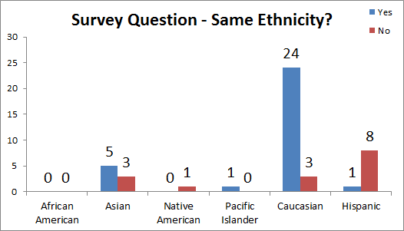
Cultural Norms and Values
•Combined Results from Intern and Alumni Surveys:

Slide 19
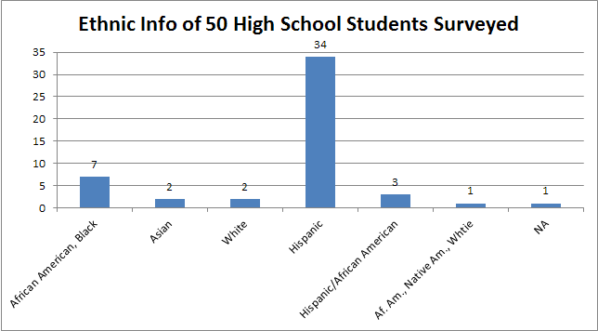

Survey of 50 High-Potential Minority Students
from Phoenix, AZ at the Be A Leader Foundation
Female: 30
Male: 15
No Answer: 5

Slide 20
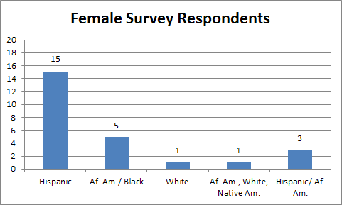
High School Survey Data Results
Of our 30 Female participants:
83.3% (25/30) are interested in pursuing degrees STEM

Slide 21
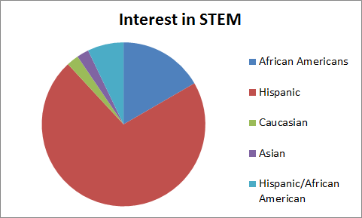
Cultural Norms and Values
Peer Mentoring?

Slide 22
Mentoring and Leadership
Dana Lerch, Public Health

Slide 23
Mentoring and Leadership
•Complication: How can AZSGC better use mentors and leaders as a way to recruit and engage underrepresented individuals?
–Who are the potential interns current mentors and leaders and how do we engage them?
–How can the space grant program (faculty and intern alumni) engage its current participants to build more productive mentor and leadership relationships?

Slide 24
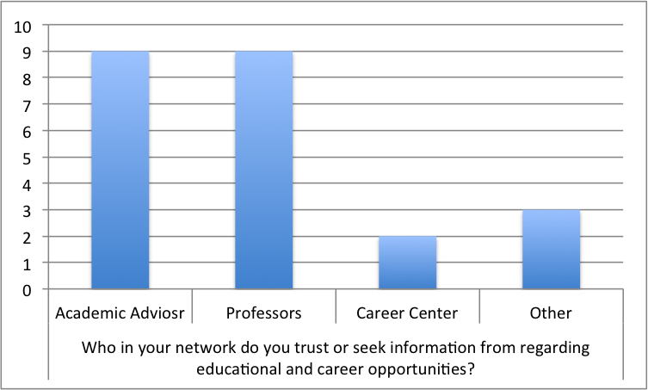
Mentoring and Leadership
Establish points of contact on campus
Academic advisors and professors
Most likely to connect students to resources, including internships and jobs, on campus (Campbell & Nutt, 2008)
Notes:
Campbell, S. M., & Nutt, C. L. (2008). Academic advising in the new global century: Supporting student engagement and learning outcomes achievement. Peer Review, 10(1), 4-7.
“…Academic advising plays a critical role in connecting students with learning opportunities to foster and support their engagement, success, and the attainment of key learning outcomes” (Campbell & Nutt, p. 4, 2008).

Slide 25
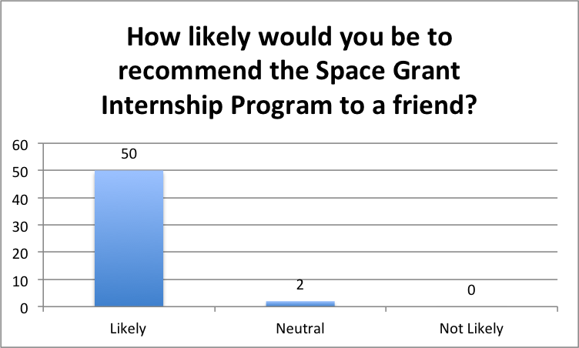
Mentoring and Leadership
Harness peer networks and leadership
Power of peer mentorship
Higher perceived levels of peer mentoring related to higher perceived levels of knowledge creation and sharing of ideas (Bryant & Terborg, 2008).
Notes:
Korver, B., & Tillema, H. (2014). Feedback Provision in Mentoring Conversation - Differing Mentor and Student Perceptions . Journal of Education and Training Studies, 2, 167-175.

Slide 26
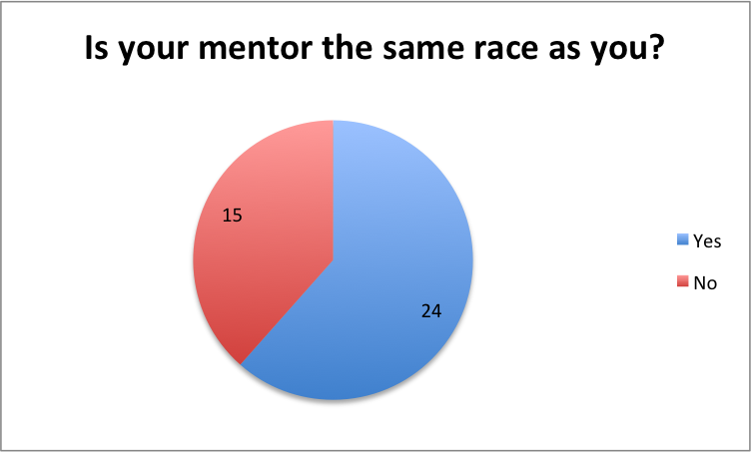
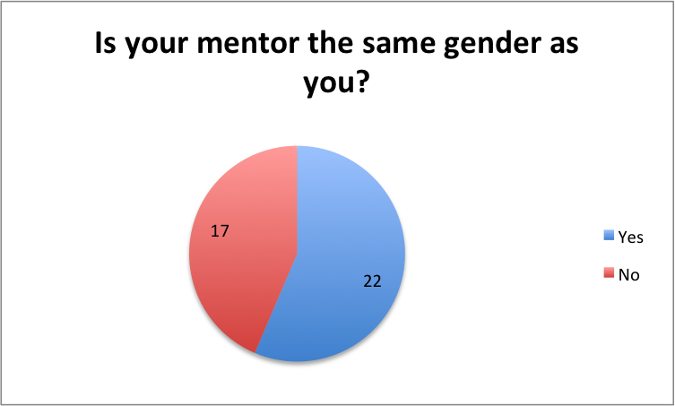
Mentoring and Leadership
“Diverging perceptions between a mentor and a mentee on the nature and content of of feedback given in mentoring conversations may have a profound impact on the mentee’s learning from conversation” (Korver & Tillema, p 167, 2013).
Notes:
Korver, B., & Tillema, H. (2014). Feedback Provision in Mentoring Conversation - Differing Mentor and Student Perceptions . Journal of Education and Training Studies, 2, 167-175.
“Diverging perceptions between a mentor and a mentee on the nature and content of of feedback given in mentoring conversations may have a profound impact on the mentee’s learning from conversation” (Korver & Tillema, p 167, 2013).

Slide 27
Areas of Study
Stephanie Wogan, Public Health

Slide 28
Areas of Study
Explore the question of diversity and relevance in relation to three topics:
Self-identification as STEM
Barriers to engagement
Interdisciplinary opportunities

Slide 29
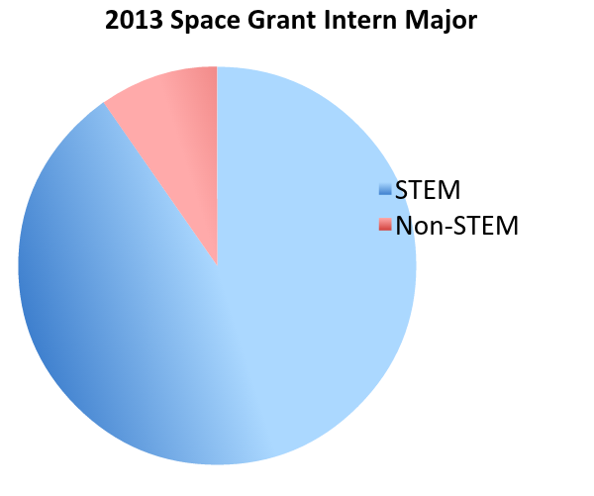
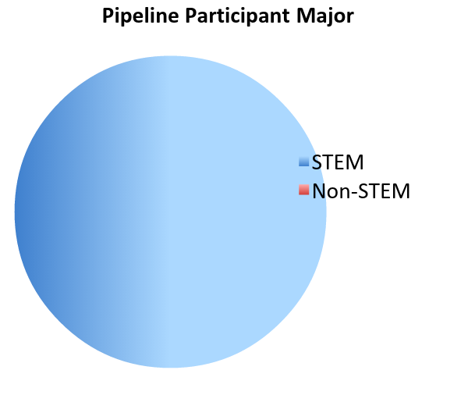
Self Identification
Increase engagement of non-STEM students
What is your major?

Slide 30
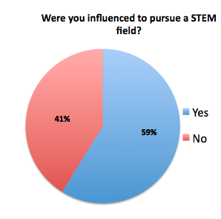
Barriers
Cultural issues, first generation students, family pressures, and lack of experience that dictate a student's decision to pursue opportunities in STEM.
  Secondary research explains, for many first generation students, the very act of going to college indicates an interest in attaining a white collar, middle class position not previously attained by a family member that may take the student into uncharted cultural territory (London, 1992).

Slide 31

Interdisciplinary
Importance of cross discipline training in teams.
  In a study conducted among health care professionals, it was found that each group agreed that the team approach benefits patients and is a productive use of time, although interprofessional differences in attitudes were evident (Leipzig, Hver, Ek, Wallenstein, Vezina, Fairchild & Howe, 2002).
Joint internship between Arizona Daily Star and Space Grant has provided the opportunity for interdisciplinary teamwork.

Slide 32
Student Involvement and Retention
Leila Shevins
Management Information Systems, Operations Management, and Retailing & Consumer Sciences

Slide 33
Student Involvement and Retention
The National Survey of Student Engagement says that student success is directly linked to student involvement (NSSE, 2009).
The engagement of past and current interns sets the precedent for how the program will expand its network for potential future interns.
Engaged of students = greater potential for word of mouth promotion

Slide 34
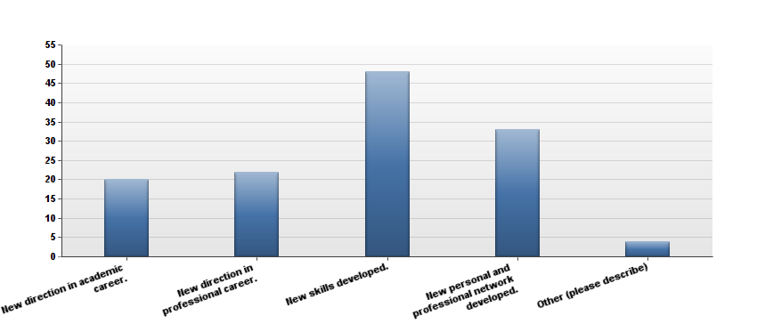
Student Involvement and Retention
The impacts Space Grant internship experience
had on the lives of alumni survey respondents
Notes:
mention recommend to friend as dana mentioned % would recommend

Slide 35
Student Involvement and Retention
“Thank you for providing what I would call my roots to my career!”
Dr. Moriba K. Jah, Astrodynamics Team Lead, AFRL, and ERAU’s first African American Intern, August 2008
According to a study on alumni engagement by Bucknell University, alumni engagement is directly linked to how much alumni are willing to give back, in time and in money
95% of AZSGC mentored interns complete university degrees as opposed to 54% of their peers (AZSGC Twenty-Year Program Performance and Results)
Building onto the “Student Advisors” program will continue student success

Slide 36
Closing Points
Ariel Fry, Anthropology

Slide 37
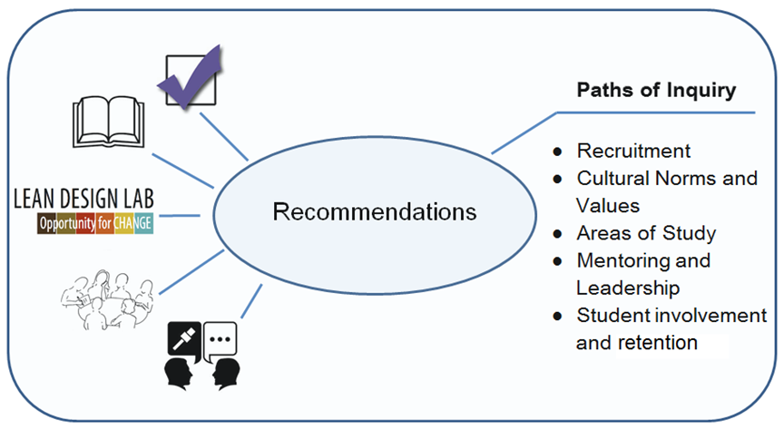
Drawing Connections

Slide 38
Benefits of Peer Engagement Study
•Raising awareness of the benefits of diversity in science
•A launch pad for thinking of these issues in really diverse and deep ways
•All of the work might raise more questions than give answers

Slide 39


Thank you!
Thank you to all mentors,
student groups, access to events,
UA/NASA Space Grant, and LeadLocal!

Slide 40
References
Bryant, S. E., & Terborg, J. R. (2008). Impact of Peer Mentor Training on Creating and Sharing Organizational knowledge . Journal of Managerial
Issues,20, 11-29. Retrieved March 28, 2014, from
http://www.jstor.org/discover/10.2307/40604592?uid=3739824&uid=2&uid=4&uid=3739256&s
Campbell, S. M., & Nutt, C. L. (2008). Academic advising in the new global century: Supporting student engagement and learning outcomes achievement. Peer
Review, 10(1), 4-7.
Chen, X., & Carroll, C. D. (2005). First-Generation Students in Postsecondary Education: A Look at Their College Transcripts. Postsecondary Education Descriptive
Analysis Report. NCES 2005-171. National Center for Education Statistics.
Donigan, K. (2013, March 8). STEM education: the value of a scientific literate population.[web log post]. Retrived April 1, 2014 From,
http://sciencepolicyforall.wordpress.com/2013/03/19/stem-education-the-value-of-a-scientifically-literate-population/
Fertig, B. (2014, April 1). Changing the Face of Astronomy [web log post]. Retrived April 1,2014 From,
http://www.npr.org/2014/04/02/297714630/changing-the-face-of-astronomy-research
Griffith, A.L. (2010). Persistence of women and minorities in STEM field majors: Is it the school that matters?[Electronic version]. Retrieved [insert date], from
Cornell University, School of Industrial and LaborRelations site: http://digitalcommons.ilr.cornell.edu/workingpapers/122/
Korver, B., & Tillema, H. (2014). Feedback Provision in Mentoring Conversation - Differing Mentor and Student Perceptions. Journal of Education and Training
Studies, 2, 167-175.
London, H. B. (1992). Transformations: Cultural challenges faced by first‐generation students. New Directions for Community Colleges, 1992(80), 5-11.
Leipzig, R. M., Hyer, K., Ek, K., Wallenstein, S., Vezina, M. L., Fairchild, S., ... & Howe, J. L. (2002). Attitudes toward working on interdisciplinary healthcare teams: a
comparison by discipline. Journal of the American Geriatrics Society, 50(6), 1141-1148.
Primary Research from: The Be A Leader Foundation, Phoenix, Arizona
Rask, K., & Bailey, E. (2002). Are faculty role models? evidence from major choice in an undergraduate institution. Manuscript submitted for publication,
Retrieved from http://citeseerx.ist.psu.edu/viewdoc/download?doi=10.1.1.195.5082&rep=rep1&type=pdf
Vedantam, S. (2014, March 21). Does Diversity on Research Team Improve Quality of Science. [web log post]. Retrieved March 22,2014, From
http://www.npr.org/2014/03/21/292225798/does-diversity-on-research-team-improve-quality-of-science

